Slide 1
Network and Cyber Security-I (CY2001) (Lecture 13)
Dr. Qaisar Shafi
Department of Computer Science,
National University of Computer & Emerging Sciences, Islamabad Campus

Slide 2
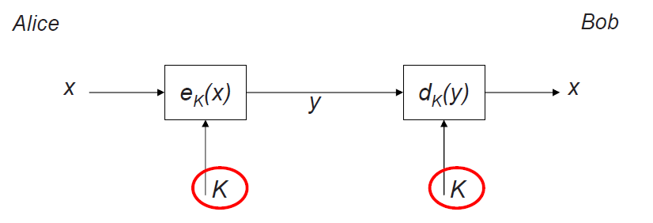
Symmetric Cryptography revisited
Two properties of symmetric (secret-key) crypto-systems:
The same secret key K is used for encryption and decryption
Encryption and Decryption are very similar (or even identical) functions

Slide 3
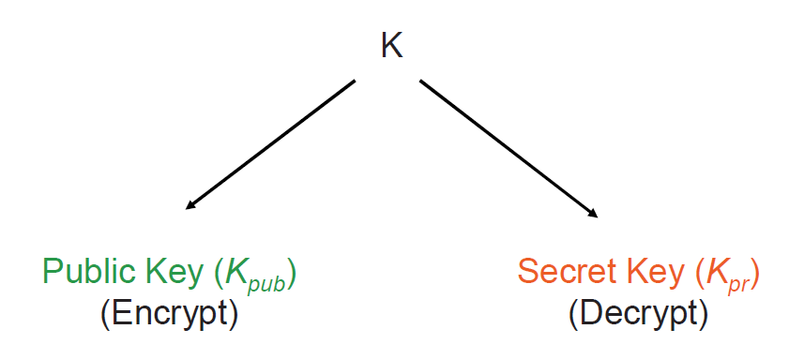
Asymmetric (public-key) Cryptography
Principle: “Split up” the key
During the key generation, a key pair Kpub and Kpr is computed

Slide 4
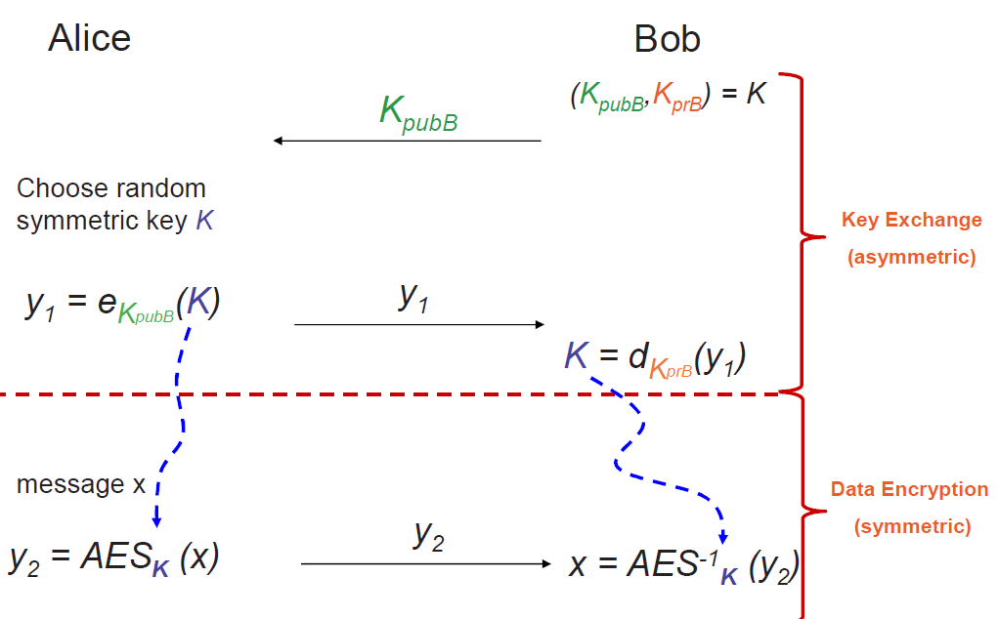
Asymmetric (Public-Key) Cryptography
Key distribution using PKI

Slide 5
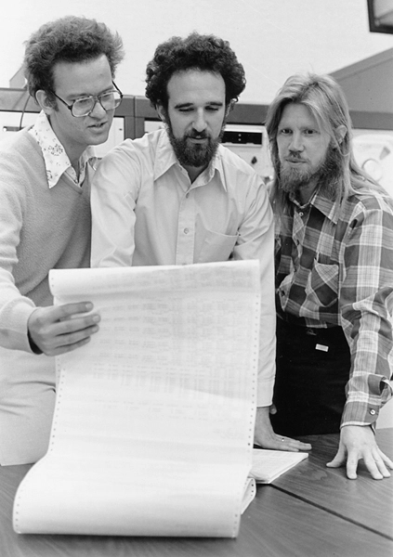
Diffie-
Hellman
Key Exchange
Protocol
Ralph Merkle, Martin Hellman and Whit Diffie proposed the first secure key exchange in 1976.

Slide 6
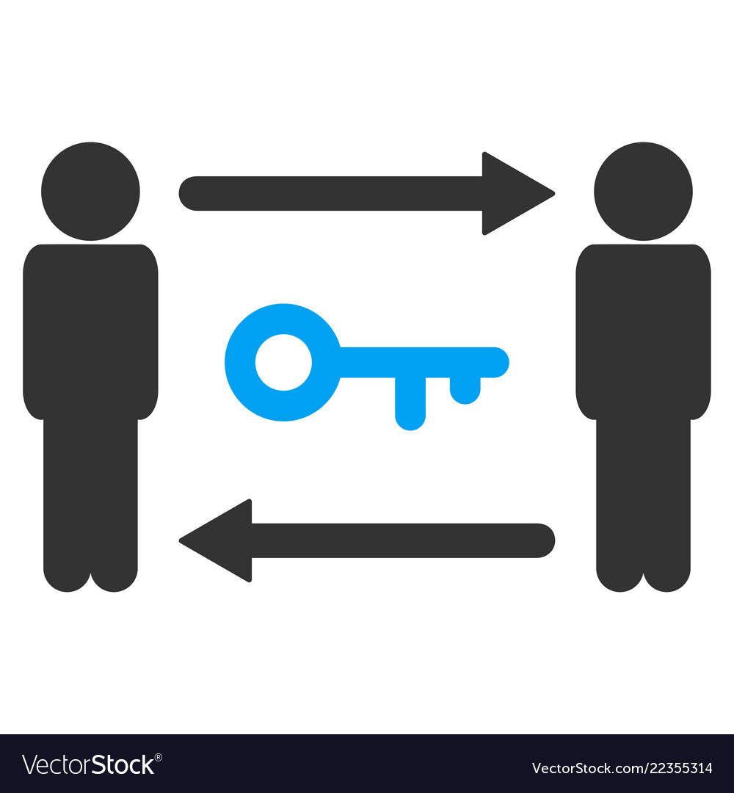
Diffie-Hellman Key Exchange
Allows group of users to agree on secret key over insecure channel
Numbers are exchanged in plain-text without encryption
Even if intruder gets the numbers, they won't be able to know the key
Security depends on the difficulty of computing “Discrete logarithms”
6
Notes:
6

Slide 7
Discrete Log Problem
Finding discrete log is a hard problem
Discrete Exponentiation x= g^{s} mod p
Discrete Log s= log_{g} x mod p
s= log₂ 9 mod 11 or 9= 2^{s} mod 11
where g is a primitive root of p
2⁰ mod 11 =1 mod 11=1 2¹⁰
2¹ mod 11 =2 mod 11=2 2¹¹
2² mod 11 =4 mod 11=4 2¹²
2³ mod 11 =8 mod 11=8 2¹³
2⁴ mod 11 =16 mod 11=5 2¹⁴
2⁵ mod 11 =32 mod 11=10 2¹⁵
2⁶ mod 11 =64 mod 11=9 2¹⁶
2⁷ mod 11 =128 mod 11=7 2¹⁷
2⁸ mod 11 =256 mod 11=3 2¹⁸
2⁹ mod 11 =512 mod 11=6 2¹⁹
3⁰ mod 11 =1 mod 11=1 3⁵
3¹ mod 11 =3 mod 11=3 3⁶
3² mod 11 =9 mod 11=9 3⁷
3³ mod 11 =27 mod 11=5 3⁸
3⁴ mod 11 =81 mod 11=4 3⁹
3 is not a primitive root of 11

Slide 8
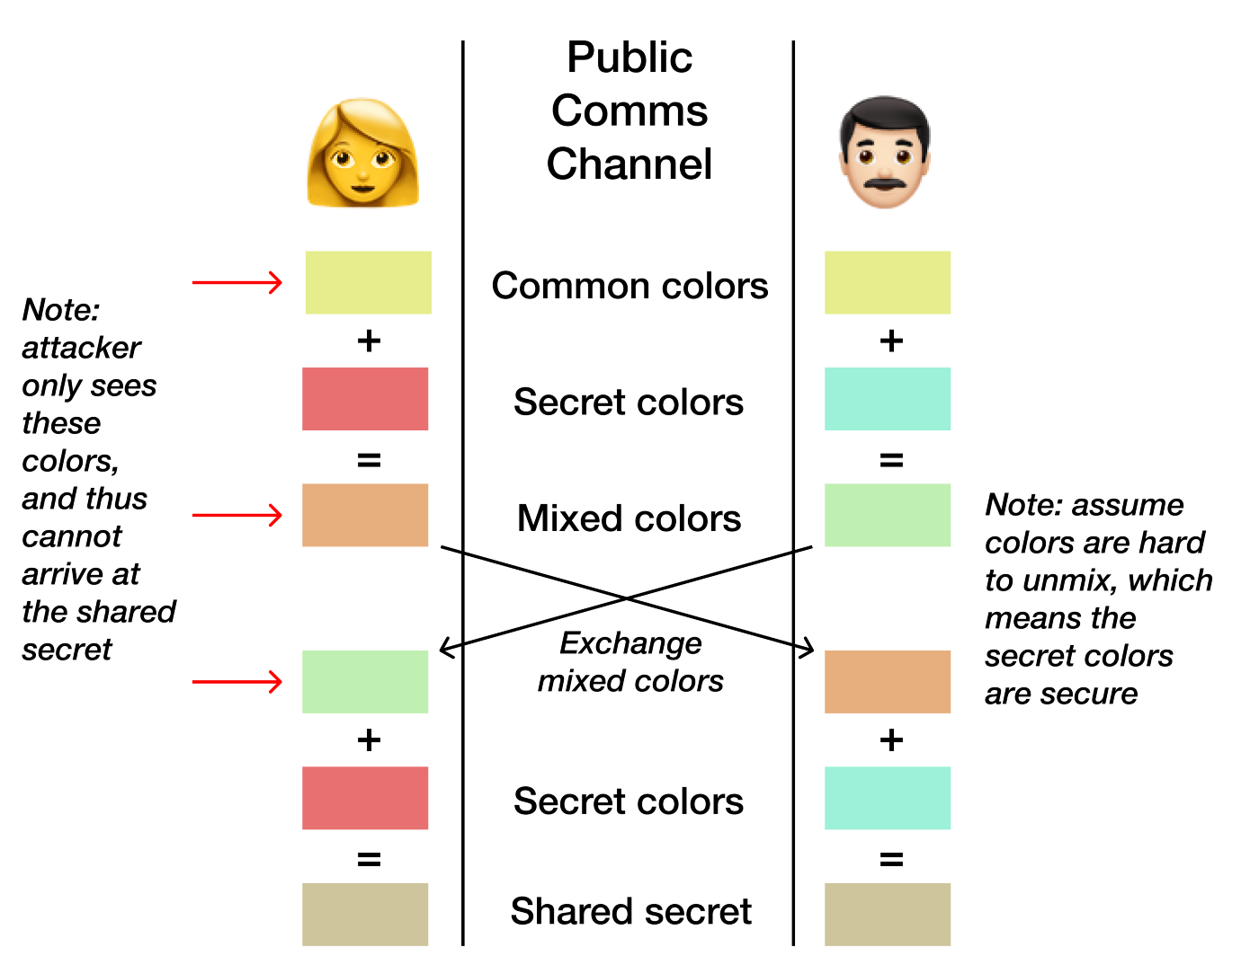
Diffie-Hellman Key Exchange

Slide 9
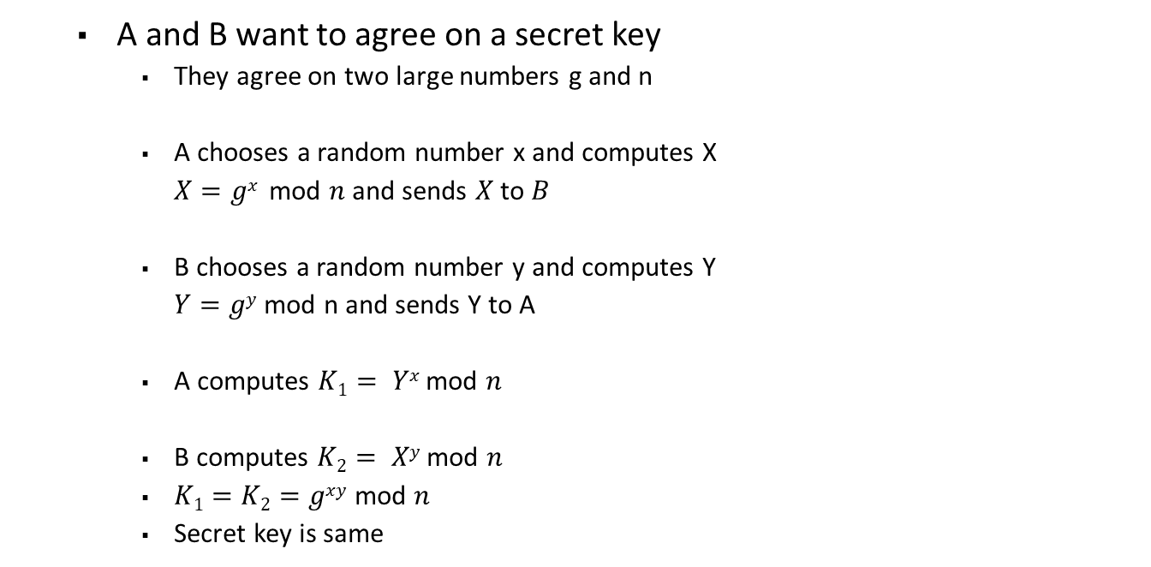
Diffie-Hellman Key Exchange
A and B want to agree on a secret key
They agree on two large numbers g and n
A chooses a random number x and computes X
$X=gx$ mod $n$ and sends $X$ to $B$
B chooses a random number y and computes Y
$Y=gy$ mod n and sends Y to A
A computes $K1= Yx$ mod $n$
B computes $K2= Xy$ mod $n$
$K1=K2=gxy$ mod $n$
Secret key is same
A
B
_{X}
_{Y}
_{Y}
I
_{n,g,X,Y}

Slide 10
Diffie-Hellman Key Exchange
X = g^{x} mod n is Discrete logarithm problem
This method requires no prior communication between A and B
Security depends on difficulty of computing x and y
Choices for g and n are critical
Both n and (n-1)/2 should be prime
g need not be large at all, and in practice is usually either 2 or 5
600 digits ~ 2048 bits
Notes:
10

Slide 11
Diffie-Hellman Key Exchange
Alice and Bob want to share a secret key using Diffie-Hellman
Alice chooses a large prime number p and a large number called the generator g which is less than p; these two values (g and p) are sent to Bob
Alice chooses a number a and calculates A = gª (mod p); the value A is sent to Bob
Bob chooses a number b and calculates B = g^{b} (mod p); the value B is sent to Alice
Alice calculates the shared secret K = Bª (mod p)
Bob calculates the shared secret K = A^{b} (mod p)

Slide 12
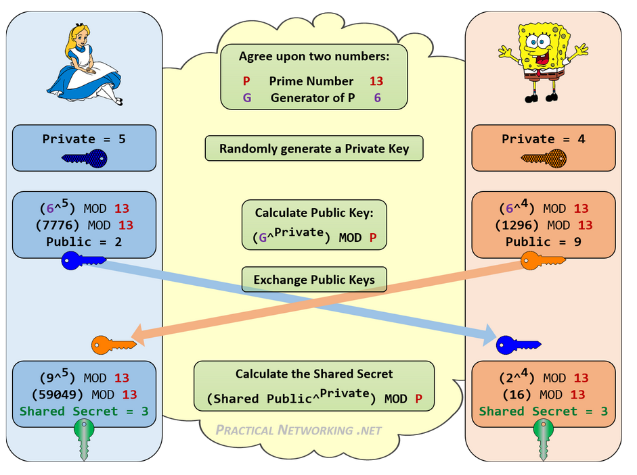
Example
Remember n actually very large number!
So are x and y!

Slide 13
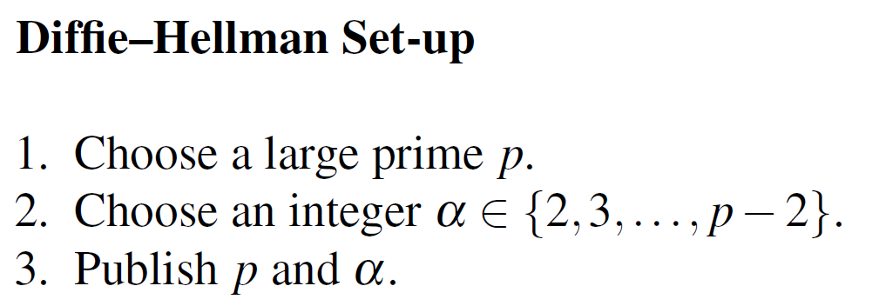
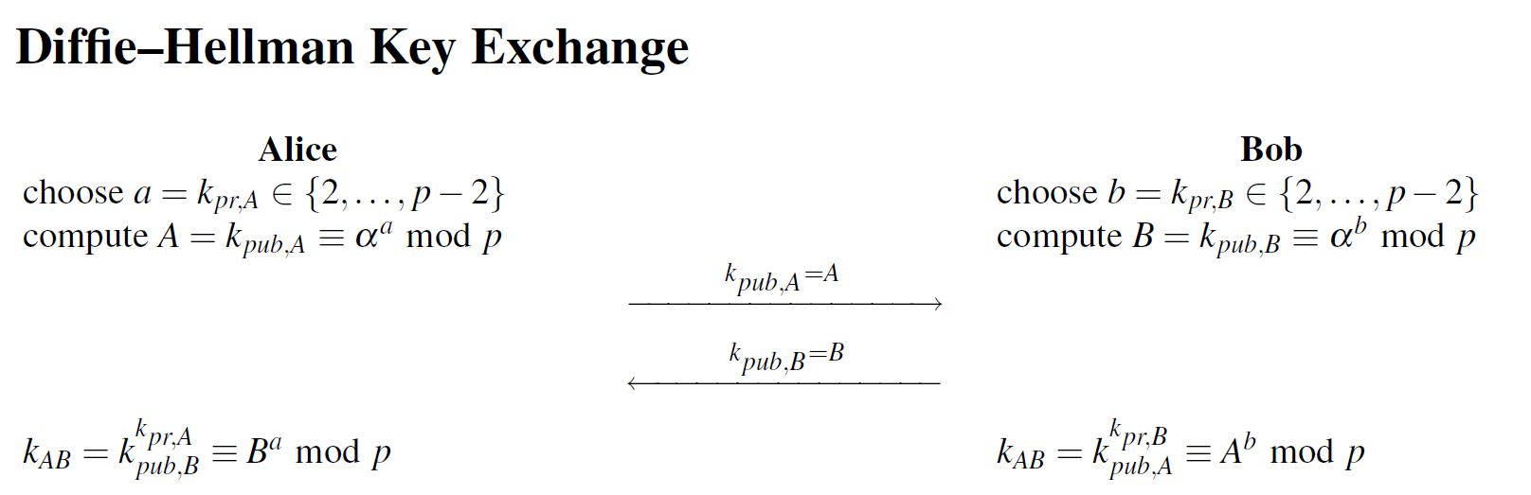

Slide 14
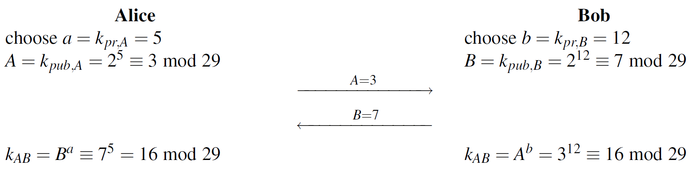

Slide 15
Solve this!
Example: g=5, n=17
Suppose A selects x=4
Suppose B selects y=2
Find the common key

Slide 16
Solution
g=5, n=17 (remember n actually very large )
Suppose A selects x=4 and computes X= 5^4 mod 17= 13 and sends to B
Suppose B selects y=2 and computes Y=5^2 mod 17=8 and send to B
A calculates 8^4 mod 17 = 16
B calculates 13^2 mod 17= 16, The common key

Slide 17
END OF LECTURE

Slide 18
Any Questions ?

